Slide 1
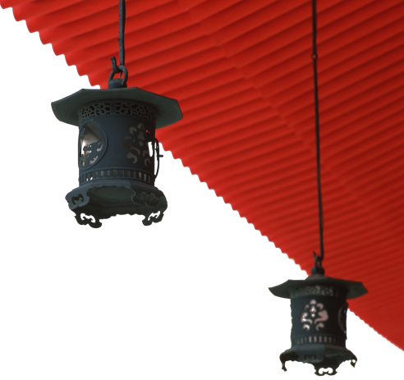


中国文化概况
A GLIMPSE OF CHINESE CULTURE

Slide 2
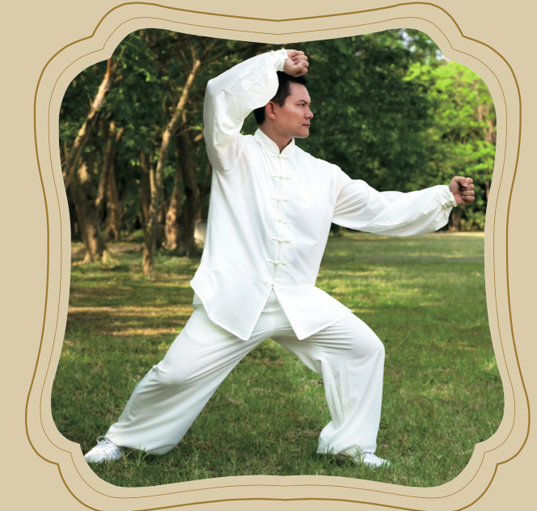
Chapter 6
Sports

Slide 3

学习目标
了解中国传统健身活动;
掌握奥运会的概况;
熟悉中国优秀体育项目。

Slide 4
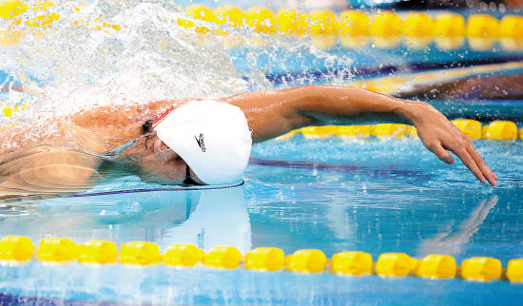
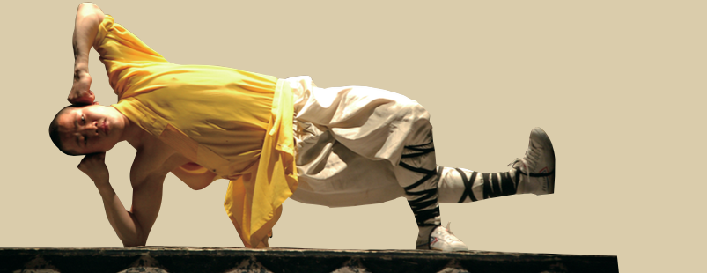
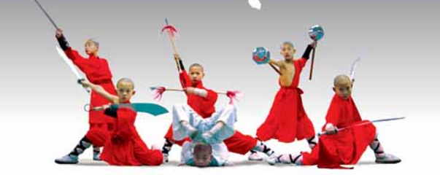
1
2
Overview
3
Lead-in Activity
Sports in China
Discussion &
Presentation

Slide 5
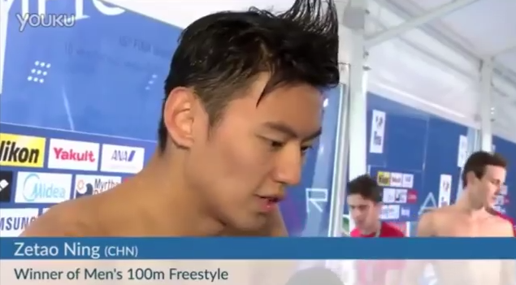
Lead-in Activity
Watch & Think
Watch the video clip and report to the class what Ning said after he took historic triumph.

Slide 6
1
2
Overview
3
Lead-in Activity
Sports in China
Discussion &
Presentation

Slide 7
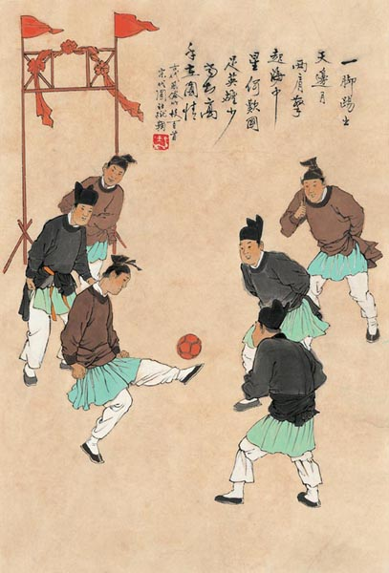
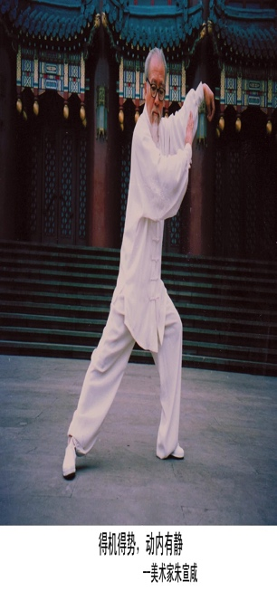
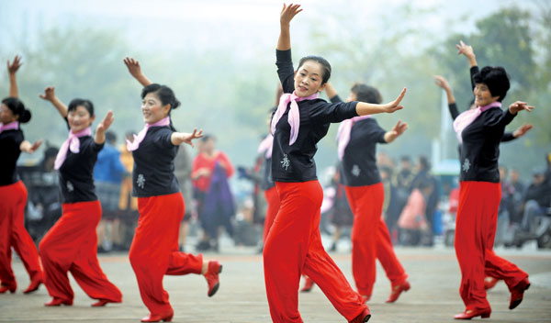
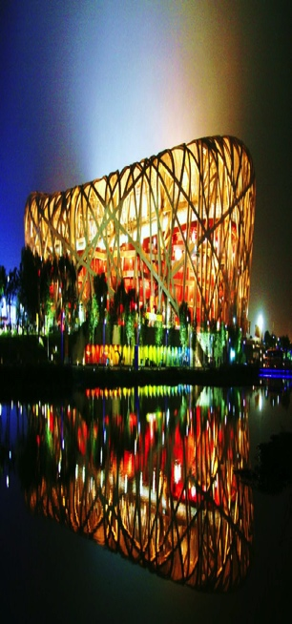
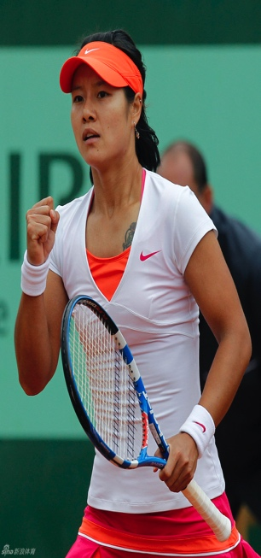
Sports in China
1
2
3
4
5
Traditional
Physical
Culture
Traditional
Physical
Activities
National
Physical
Fitness
Olympics
& China
Outstanding
Sports and
athletes

Slide 8
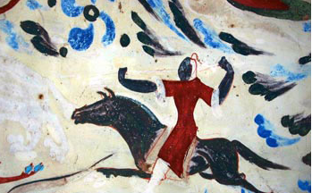
Traditional Physical Culture
Sports in Ancient Times
an important part of popular culture
began to take real shape in China during
the Qin, Han and Three Kingdoms periods.
Sporting images have been recorded over the Dynasties in sepulchral mural paintings(壁画), stone paintings, brick paintings, poems, etc.

Slide 9
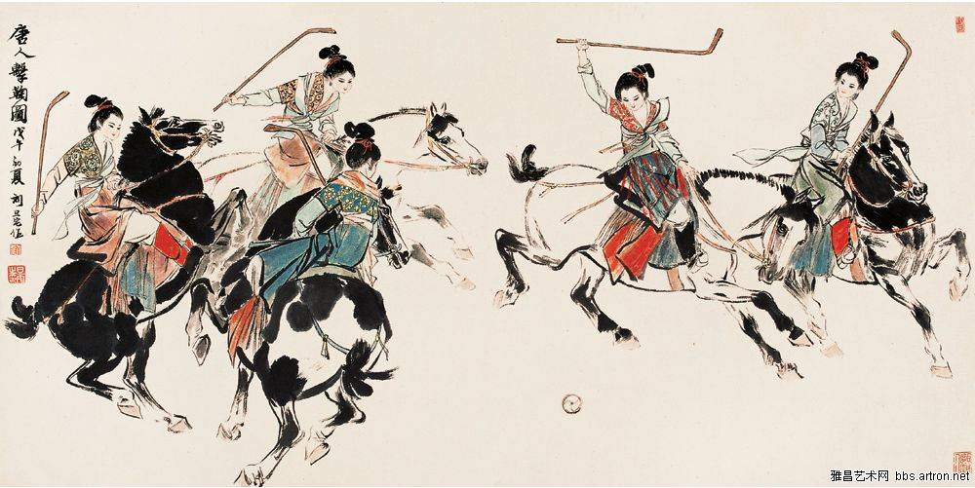
equestrian polo 击鞠
Traditional Physical Culture
popular in the palace, the army and among the men of litters(文人墨客) during the Tang dynasty.
cuju 蹴鞠
so popular in the Song Dynasty that everyone from the emperor to ordinary people participated in it.

Slide 10
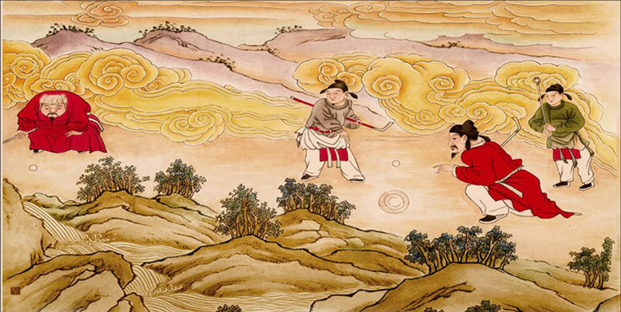
Chuiwan 捶丸
Traditional Physical Culture
In the Yuan Dynasty, people like playing a game called Chuiwan, which is similar to golf as shown in the mural Hitting Balls.
Besides ball games, wrestling, dancing, chess playing, horse racing and other forms of sports were part of the ancient people’s daily pastimes.

Slide 11
Ethnic Minority Sports
Traditional Physical Culture
Because of their unique lifestyles, ethnic minorities play sports with their own characteristics.
There are around 1,000 kinds of ethnic sports, including some well-known ones such as Mongolian wrestling, horsemanship(马术)and archery; Tibetan yak(牦牛) racing; Zhuang throwing of colored silk balls (抛绣球); Korean swinging and see-sawing jumping (跳板),etc.
Dragon boat racing, kite flying, yangge (秧歌), weiqi, and qigong are also traditional sports popular among both Han people and people of ethnic minorities.

Slide 12
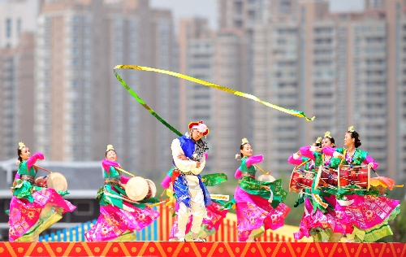
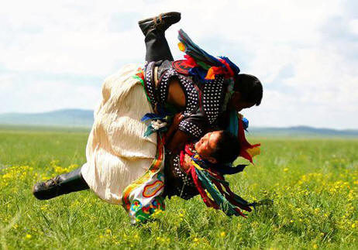
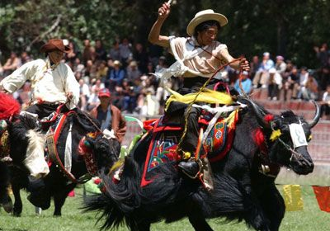
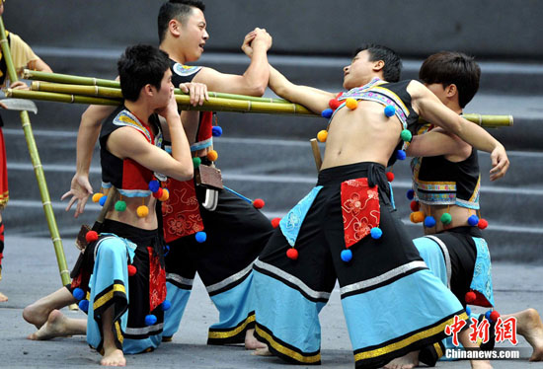
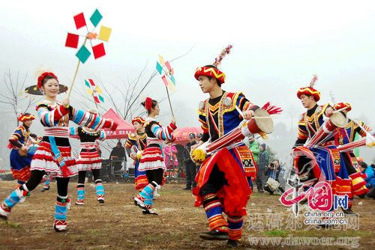
Traditional Physical Culture

Slide 13
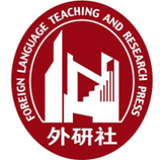
Sports in China
1
2
3
4
5
Traditional
Physical
Culture
Traditional
Physical
Activities
National
Physical
Fitness
Olympics
& China
Outstanding
Sports and
athletes

Slide 14
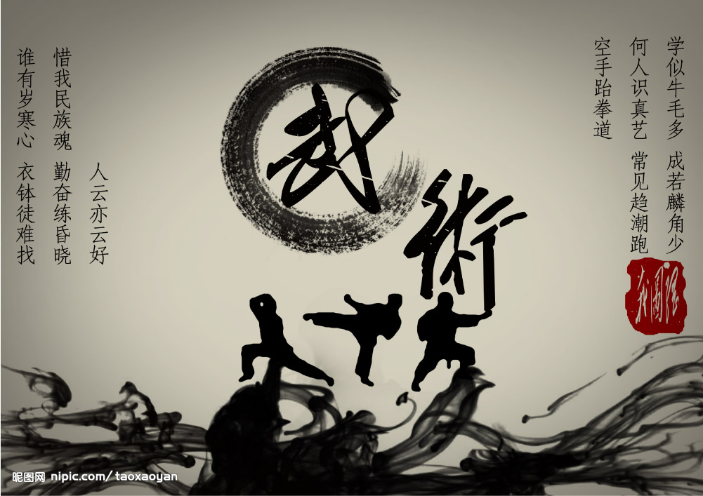
Martial Arts
Traditional Physical Activities
The most representative and typical traditional
physical activities in China
The meaning of the term “武术”
using methods and skills to stop martial actions and activities
or the martial activities between two people or two groups with the weapons.
Provide practitioners with elegance and strength
Attracts people for various reasons
Have been created and developed by the Chinese people and are a precious national cultural legacy

Slide 15
Traditional Physical Activities
Categories of Chinese Martial Arts
Boxing
Weapon exercises
Sparring exercises
Actual combat
Teamwork

Slide 16
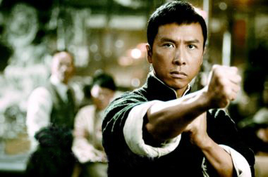
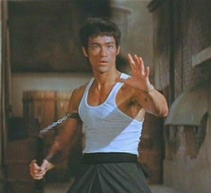
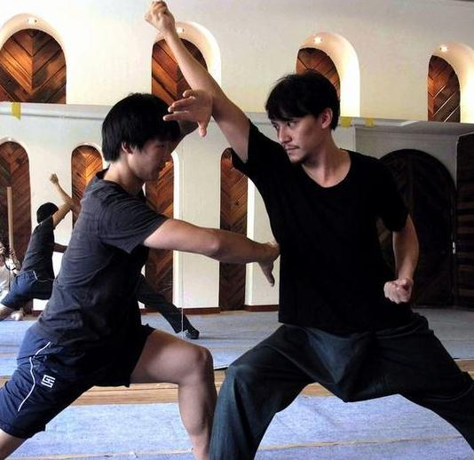
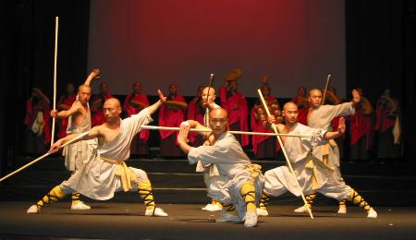
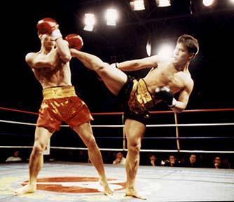
Boxing
Traditional Physical Activities
Weapon exercises
Sparring exercises
Actual combat
Teamwork

Slide 17
Traditional Physical Activities
Styles of Chinese Martial Arts
northern vs. southern styles
The Yellow River is the rough demarcation line.
the southern style: utter shouts and cries forceful.
The northern style: short, swift and vigorous routines
internal vs. external styles
Depends on which parts are trained
any good martial arts style requires a balanced combination of
the inseparable internal and external principles

Slide 18
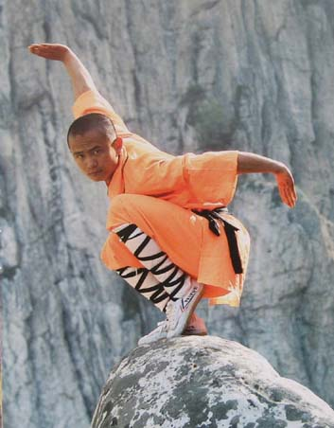
Traditional Physical Activities
Distinguished Forms of Chinese Martial Arts
Shaolin Boxing
the representative boxing style of
long boxing
Characterized by sturdiness, fast
attacks, and coordinated forward
and backward moves
Its serial moves are mostly short and
straight.

Slide 19
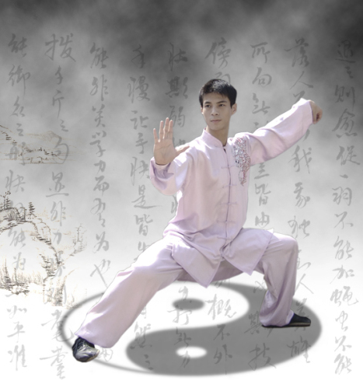
Traditional Physical Activities
Tai Chi Chuan太极拳
A popular school of martial arts
Marked with slow and gentle movements
Designed for defense, strengthening of
physical and prevention of diseases
The mind guide the body through
graceful, gentle and firm movements.
Originated in Henan province and had
developed many different schools

Slide 20
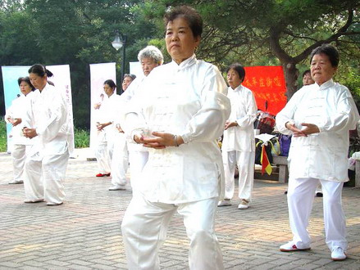
Traditional Physical Activities
Qigong
Practiced by the Chinese on a regular basis to keep fit.
“Qi ” literally means “air” and implies “life force”
The purpose of qigong is to coordinate the health of the
mind and body.
Two categories：
the quiescent type
the mobile type

Slide 21
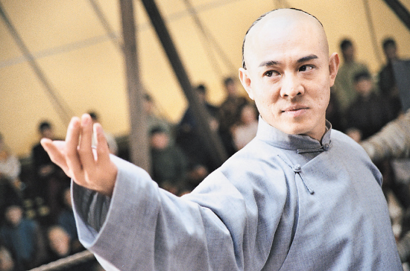
Superstars of Modern Martial Arts
Traditional Physical Activities
contribute to the Chinese and even Asian culture
have opened the door for people of all races and cultures, and are
followed by countless people in pursuing their kung fu dreams

Slide 22
Sports in China
1
2
3
4
5
Traditional
Physical
Culture
Traditional
Physical
Activities
National
Physical
Fitness
Olympics
& China
Outstanding
Sports and
athletes

Slide 23
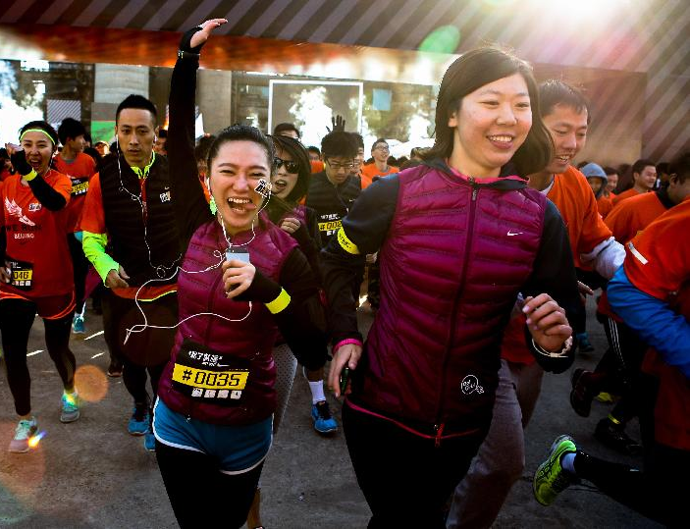
National physical fitness
Chinese people nowadays are paying more and more attention to fitness, and their lifestyle has changed a lot.
gymnasiums and stadiums, as well as body-building equipment
people begin to engage in their own ways to keep fit.

Slide 24
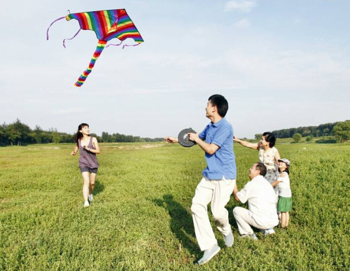
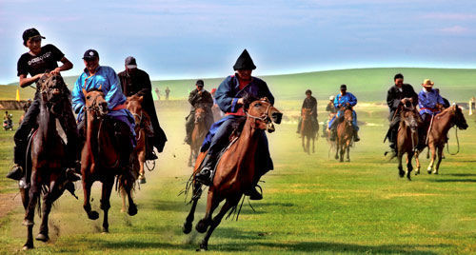
Kite Flying
National physical fitness
a traditional Chinese pastime with millions of
participants across the nation
The Weifang (in Shandong province)International
Kite Festival attracts tens of thousands of
participants from all over the world.
Horse racing
essential to the lifestyle of many ethnic groups.
There are regional variations and the types of competition are diverse.

Slide 25
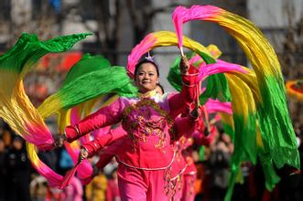
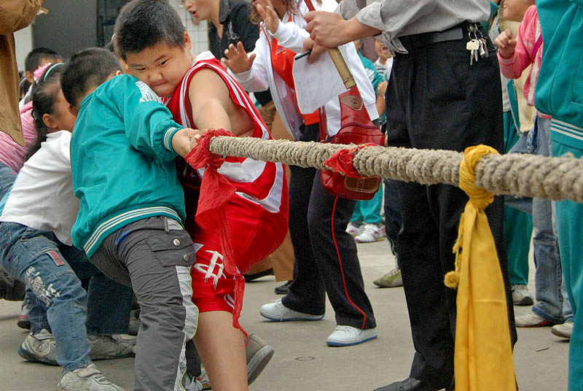
Yangge
National physical fitness
a traditional dance accompanied by rhythmic folk music or singing, with the dancers dressed in costumes and holding fans or handkerchiefs.
very popular in many areas of northern China and among the middle-aged and elderly.
Tug-of-War (拔河)
a traditional game in which many ethnic groups participate with vigor.
provides much entertaining highlight and causes considerable good-natured amusement.

Slide 26
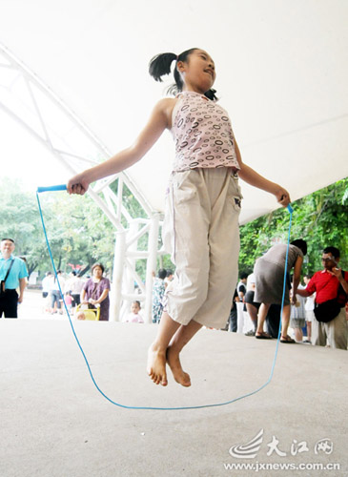
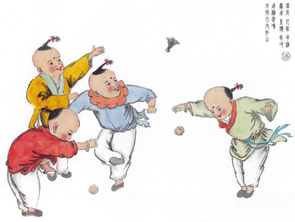
Rope Skipping (跳绳)
National physical fitness
Shuttlecock Kicking (踢毽子)
a fun sport for both children and adults.
With simply a rope, people have invented many ways to play and compete.
There are many variations in terms of styles and methods of kicking
Not only brings a lot of fun, but also provides vigorous physical exercise
convenient to play and can be practised anywhere and anytime.

Slide 27
Sports in China
1
2
3
4
5
Traditional
Physical
Culture
Traditional
Physical
Activities
National
Physical
Fitness
Olympics
& China
Outstanding
Sports and
athletes

Slide 28
About the Olympics
The Olympic Games and China
an international sport competition, held every four years.
The Olympic motto: faster, higher, stronger.
Originated in ancient Greece between 776 BC and 393 AD
Revived in modern times thanks to the work of French educator and thinker Pierre de Coubertin.
The first modern Olympic Games were held in Athens in 1896.

Slide 29
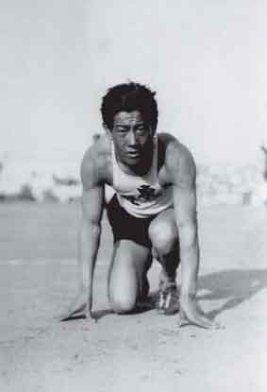
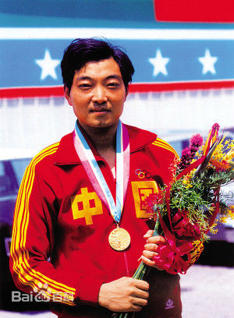
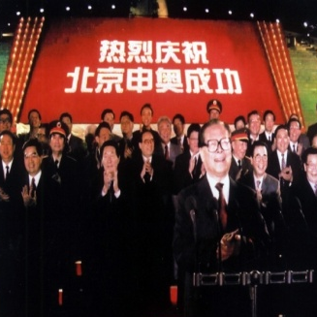
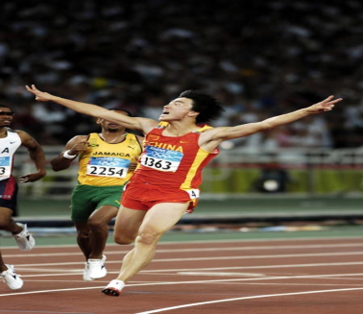
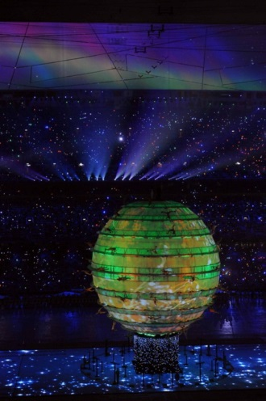
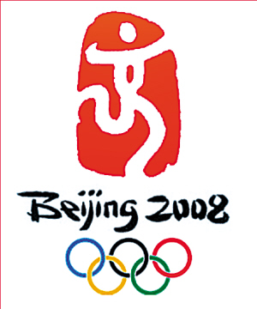
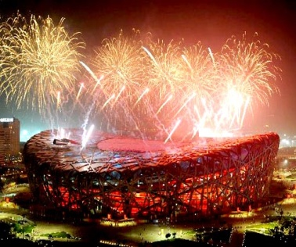
The Olympics and China
The Olympic Games and China
China was invited for the first time in 1932
The only Chinese participant at those Games was Liu Changchun, who entered the 100 m and 200 m race but was eliminated (淘汰) in the first round.
The first gold medal winner in Chinese Olympic history: Xu Haifeng, a sharpshooter.
In 2001, Beijing won the right to host the 29th Olympic Games in 2008.
The 2008 Beijing Olympic Games became one of the best in history

Slide 30
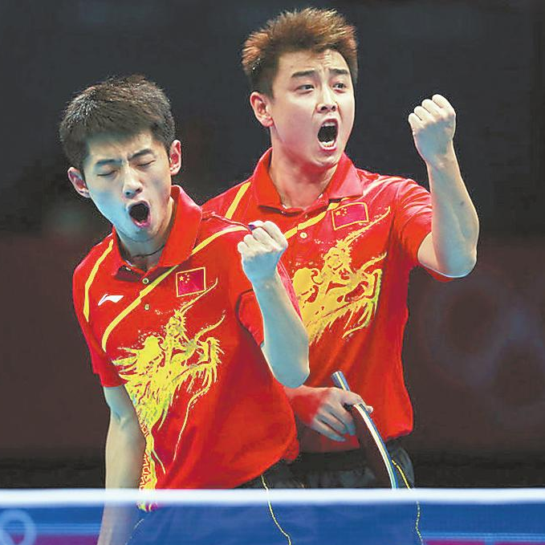
Chinese Outstanding Competitive Sports
The Olympic Games and China
Table Tennis
the “National Ball Game” of China.
Chinese table tennis players have performed exceptionally well in international competitions.
has given millions of Chinese a taste of national glory and prestige.
once made a great contribution to the diplomacy of China. (“Ping-Pong Diplomacy”)

Slide 31
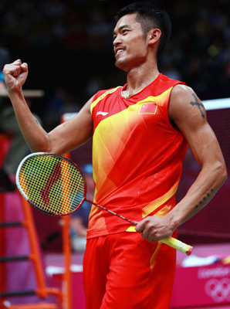
The Olympic Games and China
Badminton
China became a formal member of the International Badminton Federation in 1981.
Since then, Chinese badminton teams have won the Thomas Cup (托马斯杯) nine times, the Uber Cup (尤伯杯) 12 times and the Sudirman Trophy (苏迪曼杯) nine times by 2013.

Slide 32
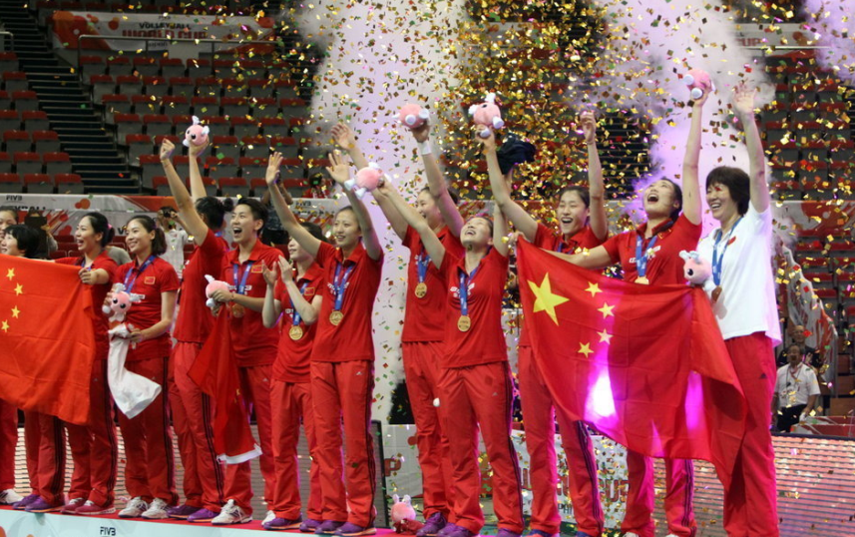
The Olympic Games and China
Volleyball
One of the best women’s volleyball teams in the world.
The Chinese Women’s volleyball team and its struggle for success was an inspiration to the Chinese people during the 1980s.

Slide 33
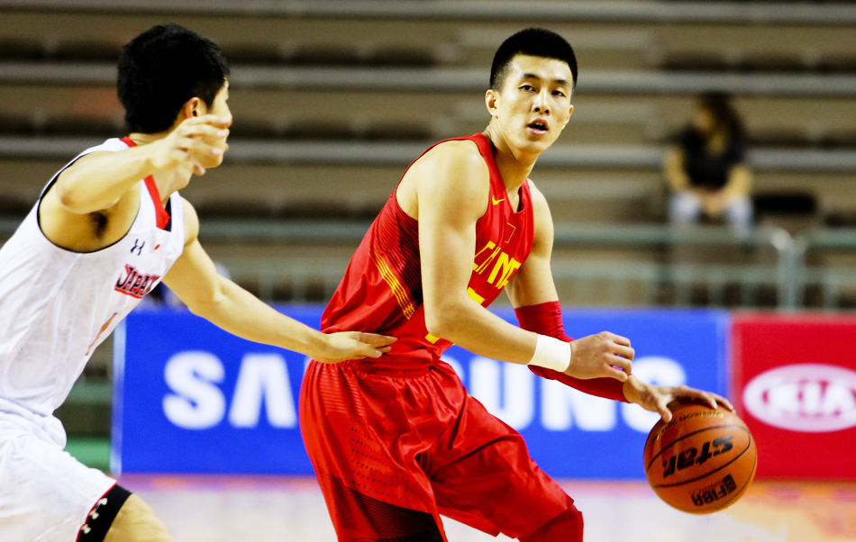
The Olympic Games and China
Basketball
CBA（中国男子篮球职业联赛）: a non-government organization managing basketball at the national level
CBAC（中国篮球协会）: responsible for promoting the sport in China
The advent （到来）of the CBA league represented a giant step in the development of professional basketball in China.
The Chinese women’s basketball team is an awesome power in the world basketball arena.

Slide 34
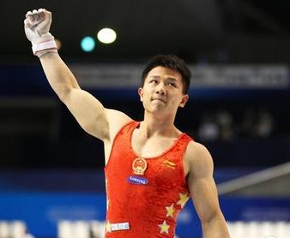
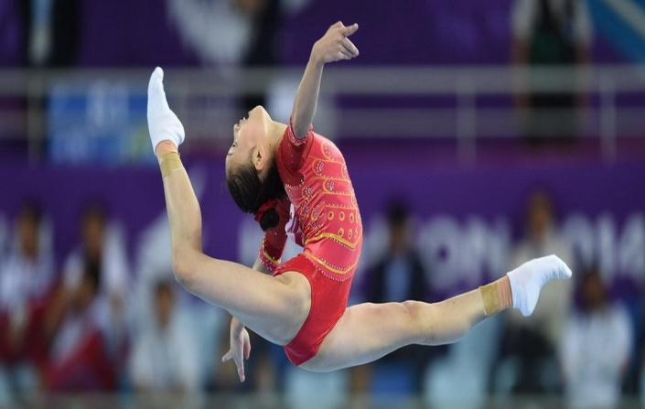
The Olympic Games and China
Gymnastics
excels internationally
Chinese gymnasts have proven themselves to be among the most reliable of the Chinese Olympic squad
At the 2008 Beijing Olympic Games, the Chinese gymnastic team won unprecedentedly nine gold medals.

Slide 35

The Olympic Games and China
Outstanding Chinese Sports Stars in the 21st Century
Yao Ming
an international basketball superstar
played for the Houston Rockets of the
NBA in the USA from 2002 through 2011
selected to start for the Western Conference
in the NBA All-Star Game eight times
named to the All-NBA Team five times.
reached the NBA Playoffs four times.
enjoys enormous popularity both in the
United States and in China

Slide 36

The Olympic Games and China
Outstanding Chinese Sports Stars in the 21st Century
Sun Yang
A Chinese Olympic and world-record-holding distance swimmer.
broke the world record in the men’s 1500 metres freestyle at the
2011 World Championships
the first Chinese man ever to win an Olympic gold medal in the
men’s 1500 metres freestyle.

Slide 37

The Olympic Games and China
Outstanding Chinese Sports Stars in the 21st Century
Liu Xiang
the first Chinese man who got an Olympic
gold medal in a track and field event.
the first Chinese athlete to achieve the “triple
crown” of athletics — world record holder,
world champion and Olympic champion
has become one of China’s most commercially
successful athletes and has emerged as a
cultural icon.

Slide 38

The Olympic Games and China
Outstanding Chinese Sports Stars in the 21st Century
Li Na
The first and only Grand Slam singles champion（网球）
from Asia. Before the first player representing an Asian country to appear at a Grand Slam singles final
In January 2014, Li Na became the champion of
the Australian Open, making her rank third in
the world and first in China.

Slide 39

The Olympic Games and China
Outstanding Chinese Sports Stars in the 21st Century
Ding Junhui
Currently China’s most successful snooker player ever.
The youngest winner of the IBSF World Under-21 Championship
The youngest player to make the 147 maximum (单杆满分)break in
professional competitions ever.

Slide 40
Discussion
China has successfully hosted the 2008 Olympic Games, which helped promote traditional Chinese culture globally and enhanced the trust and friendship among the peoples of different nations. Discuss with your partner:
How Beijing 2008 Olympic Games have helped people outside China gain a good understanding of Chinese culture? Then share your ideas with the class.

Slide 41
Students’ Presentation
With a long history, China has developed a great variety of unique and traditional sports and pastimes. You are a Chinese university student who is invited to give a two-minute presentation to a group of international students who show great interest in traditional Chinese sports
Your presentation should include the following points:
1 its origin
2 its feature
3 its global influence.

Slide 42


Students’ Presentation
A little inspiration for you
Welcome to the World of Ancient Chinese Sports

Slide 43
The End

